Slide 1
Truck Scale GUI
Created By:
Robert Burton
Robert Hall
Colton Edwards

Slide 2

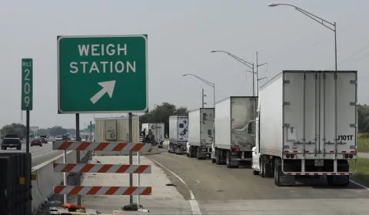




General Design
Our program is being designed to act and preform as a professional weigh station would.

Slide 3
Brief Overview
The main goal of the program was to make a GUI front end , classes supporting the GUI in the background to simulate a program a truck weight station would use.
It is built with Java SDK with Java Swing as the GUI framework.
We used Object Oriented programming to ensure the classes and methods that we used will all work together to make a solid program.
User can do tasks such as:
Add a new driver.
Remove a driver.
Add ticket for driver.
Select a user for viewing on the main window.
Input validation was key here. Inputs from user are analyzed to make sure garbage data does not go into the program to cause problems.

Slide 4

Colton Edwards
Worked on the back-end classes, tested the GUI, and worked on the PowerPoint.
Time spent on program: too long
Favorite food: chicken and rice

Slide 5

Robert Hall
Worked on the GUI, and added all comments and Javadocs to the code.
Time spent on program: too long.
Favorite Food: Sushi

Slide 6

Robert Burton
Worked on this PowerPoint, UML Diagrams, and back-end classes.
Favorite food: Steak and a baked potato.

Slide 7
Features to our program:
Our program includes a number of different things a user can do:
User can:
Add a new drivers to the list of drivers.
Delete a drivers from the list of drivers.
Add a ticket to a driver.
View and display on the main screen a driver.
Choosing a driver in the menu clears the old one out, and updates information about driver as needed.
Adding a ticket to a driver will update main screen information.
The main method is included in the TruckScaleGUI, the constructor for the class displays the GUI and the button components have actions behind them which allow our program to communicate.

Slide 8
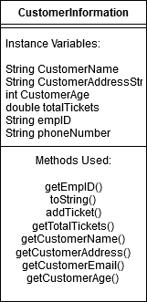
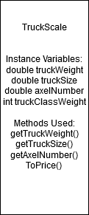
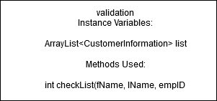
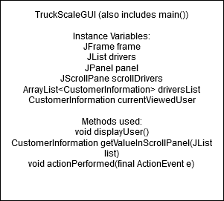
UML Diagrams for classes.
- Here is the UML Diagrams for the classes we used.
CustomerInformation and TruckScale all have setter methods not included here.
- The “validation” class is used for searching a list of drivers, and returning a -1 if the driver is not in the list. It returns the index of the item if it is available.

Slide 9
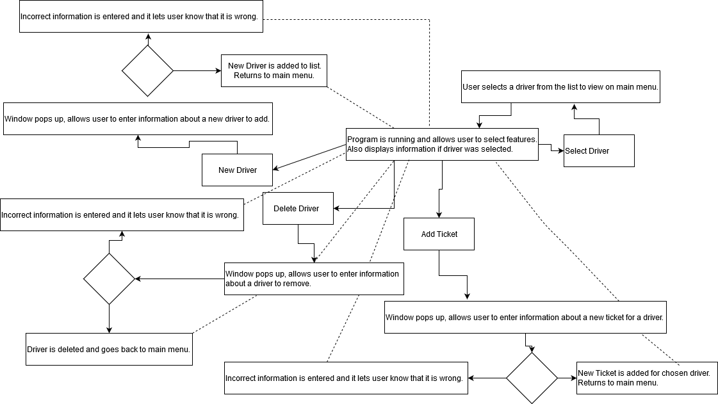
Flowcharting our program

Slide 10
Java Concepts used:
Classes
Inheritance
Object Oriented Programming
Constructors
Arrays
ArrayLists
Java Swing ( for GUI )
Get and set methods for classes.
Encapsulation

Slide 11
How did we communicate?
Normally whenever people do group projects such as this, they use either groupMe or another group chat client.
However since we all had iPhones we just had a group chat there with all of our phone numbers.
All code that was passed around for viewing and working on was done via email. Anytime a change was made to any class, we had to make sure the GUI still worked properly with the newly edited .java file.

Slide 12
Summary, thoughts, and challenges.
Overall, the program works better than anticipated. If we had a whole semester to work on it, we could have added more features to it for more functionality. However, it works perfectly fine for our requirements.
The GUI allows the user to do certain actions emulating a program that would be used at an actual truck weight station.
Hardest part of the program was all of us testing the program to make sure all features of it worked. Multiple times we had to go back and figure out why a certain thing wasn’t displaying, validating inputs to make sure garbage data doesn’t get collected, and many other tasks with the GUI.
The GUI design was a group effort and we had to make sure everything lined up and looked just like we planned.

Slide 13
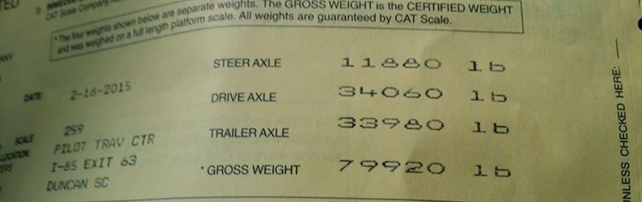
Questions?

